Slide 1
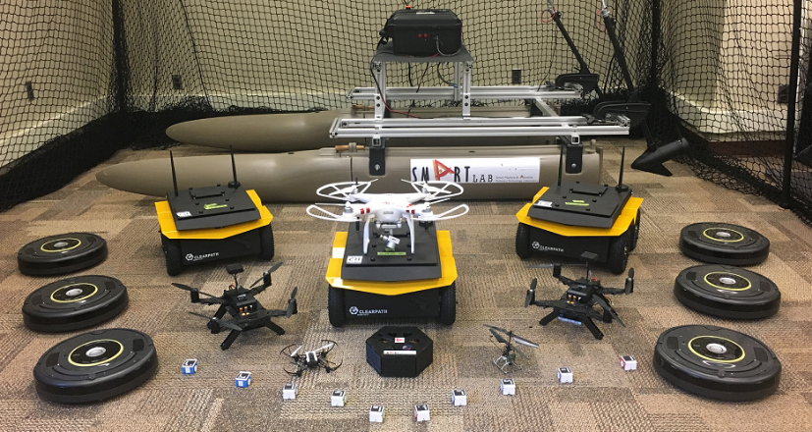
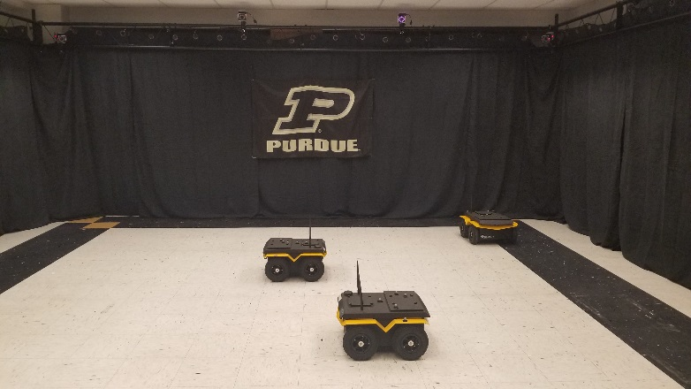

Slide 2
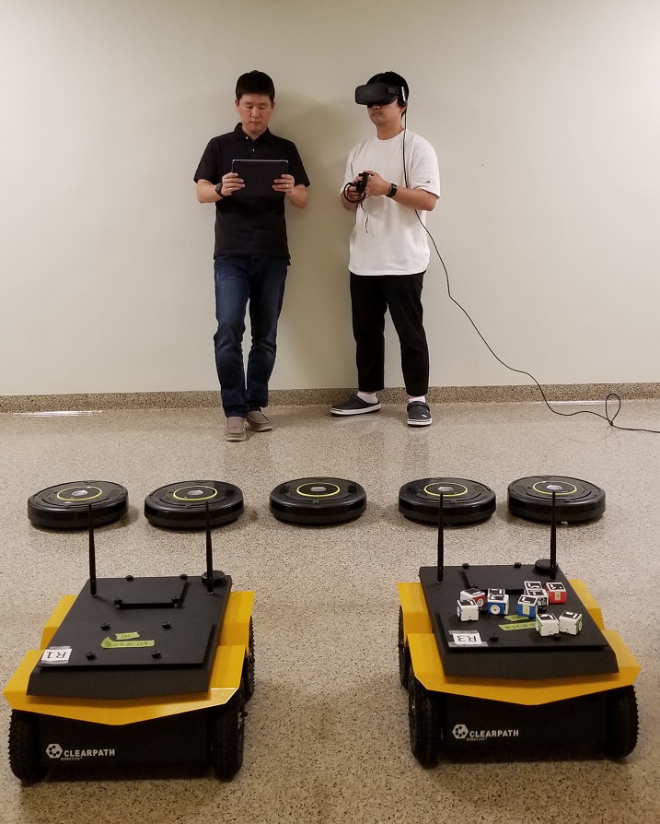
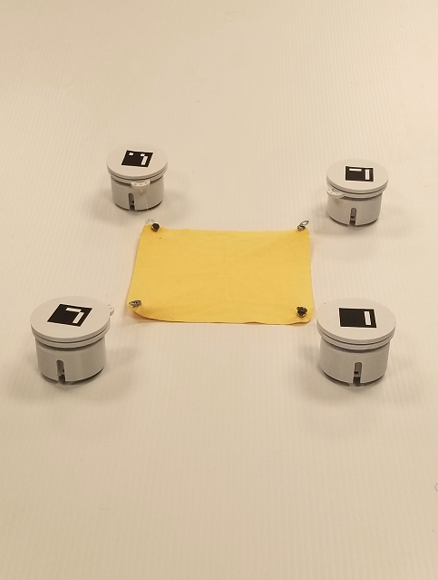
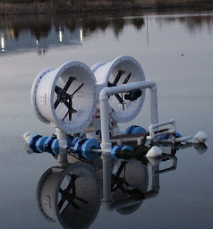
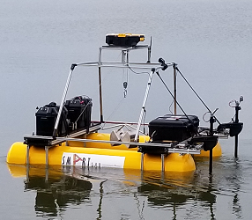

Slide 3
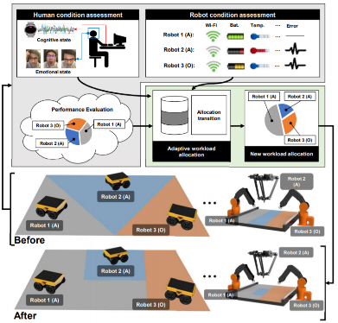
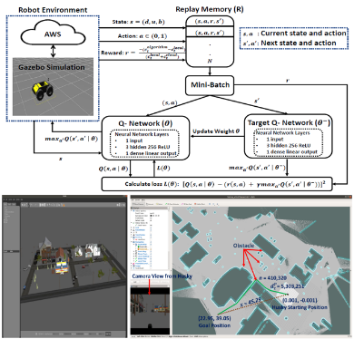
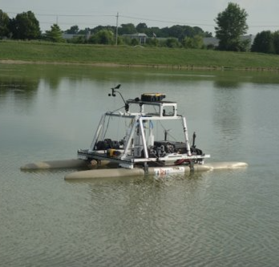


Slide 4
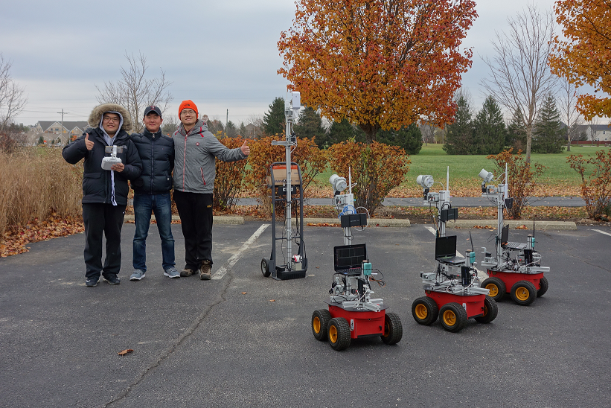
MATLAB simulation with 100 mobile robots
Developed mobile robot platform
Preliminary tests with 3 mobile robots
Notes:
Approaches
We deploy mobile robot team equipped with wireless communication components as testbed and verify the rendezvous control scheme.
Experiments
We designed several scenarios for rendezvous control scheme test. The first is robot system determines the hierarchy and the parent waits for its children then they change hierarchy and maneuver to the destination. We are going to test the other scenarios such as robot system convoy to the destination without changing the hierarchy, and the scenario with small obstacles which should be avoided in maneuvering.

Slide 5
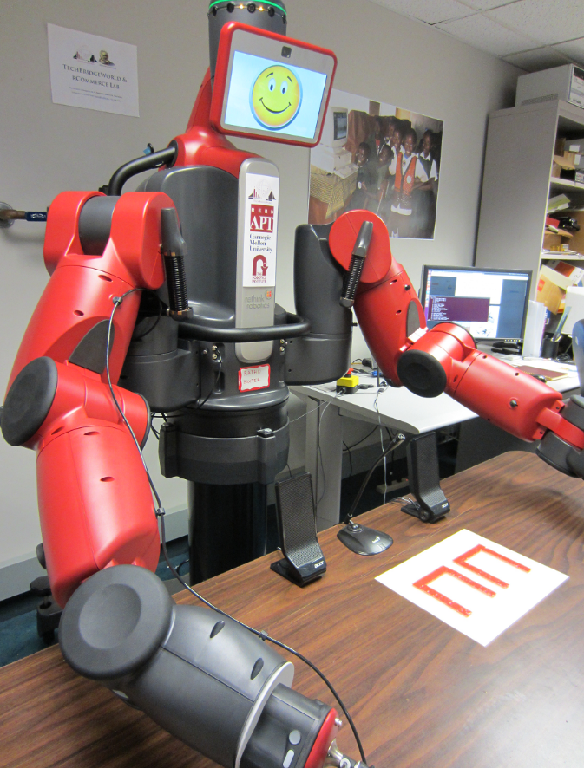


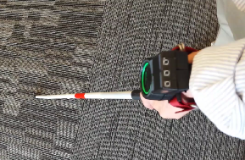
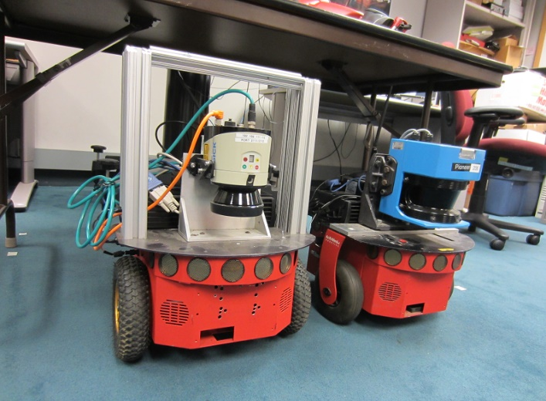
Human-machine Interaction
Humanoid Robot
Mobile Guide Robots

Slide 6

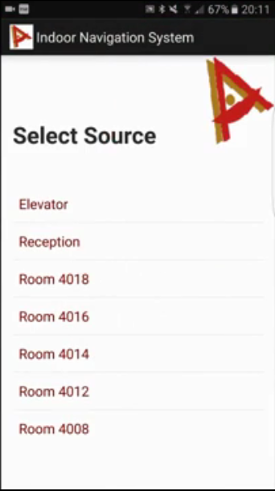
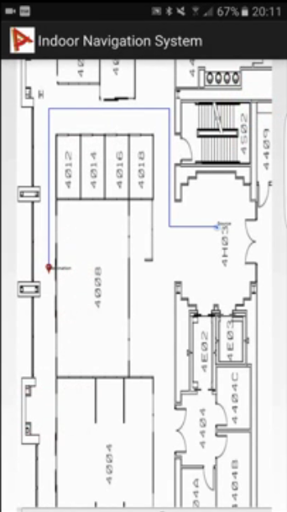
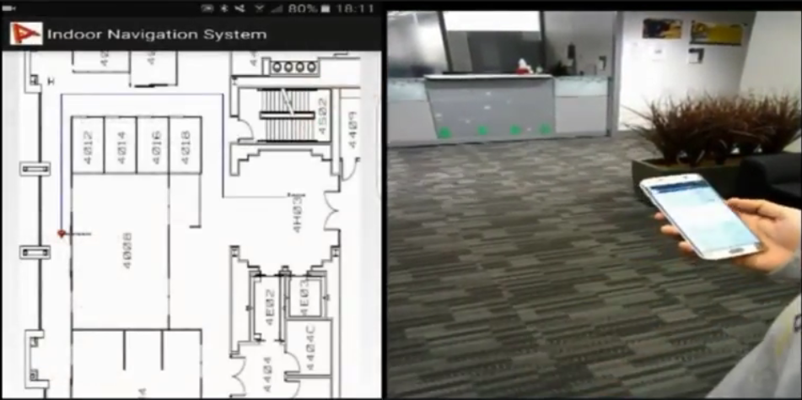
Android based mobile App
Demonstration in indoor environments
Notes:
Approaches
We deploy mobile robot team equipped with wireless communication components as testbed and verify the rendezvous control scheme.
Experiments
We designed several scenarios for rendezvous control scheme test. The first is robot system determines the hierarchy and the parent waits for its children then they change hierarchy and maneuver to the destination. We are going to test the other scenarios such as robot system convoy to the destination without changing the hierarchy, and the scenario with small obstacles which should be avoided in maneuvering.

Slide 7
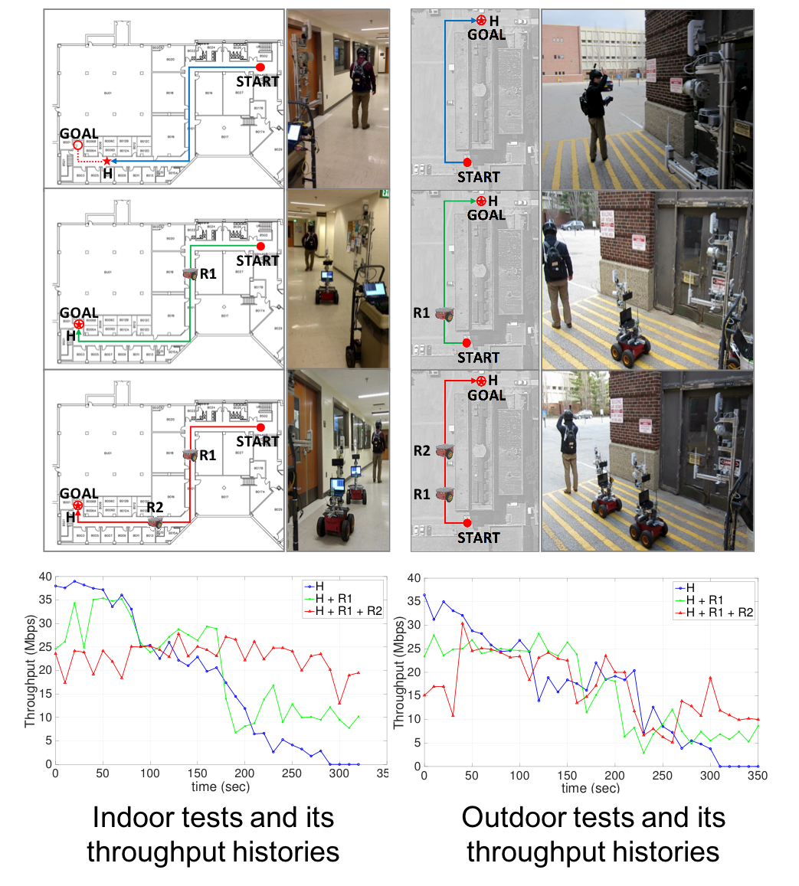
Indoor tests & throughput results
Outdoor tests & throughput results

Slide 8
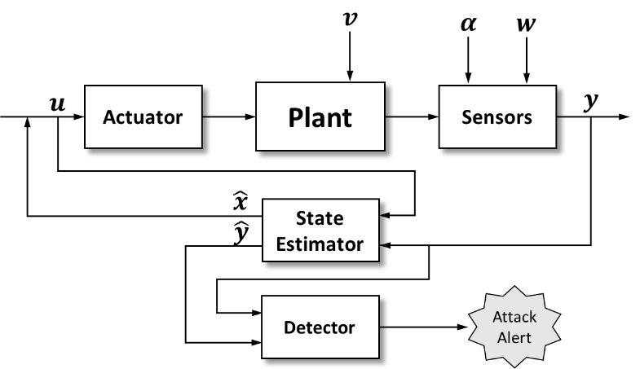
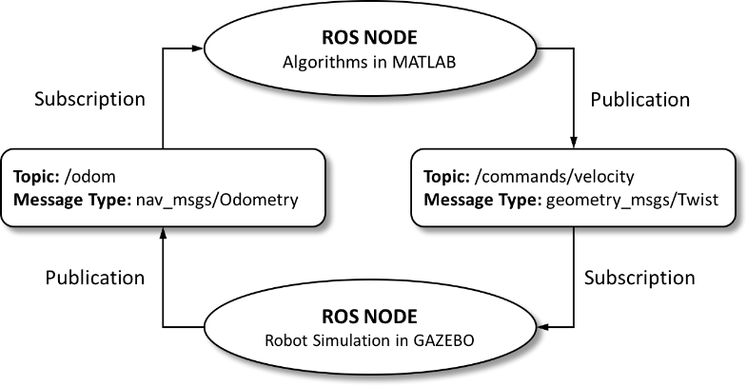
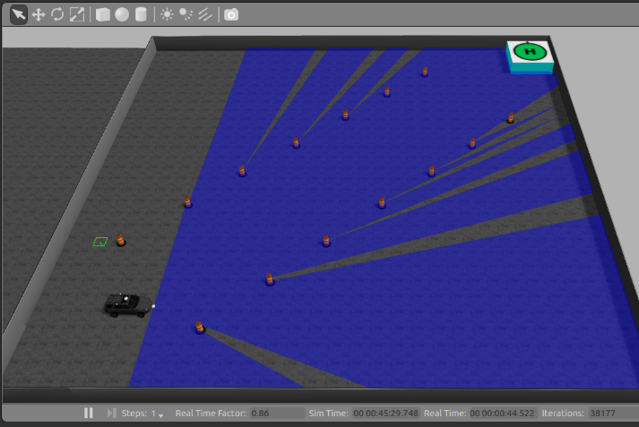
Feedback loop between ROS environment variables
Overview of the attack-aware
multi-sensor integration system
Robotic simulator (GAZEBO)
Evolution of test statistics

Slide 9
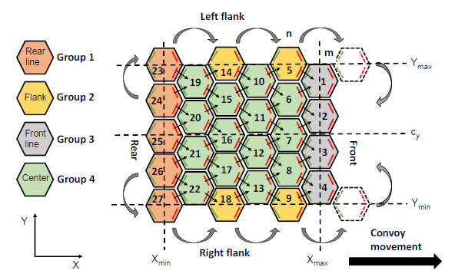
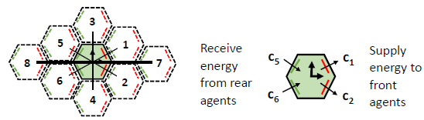
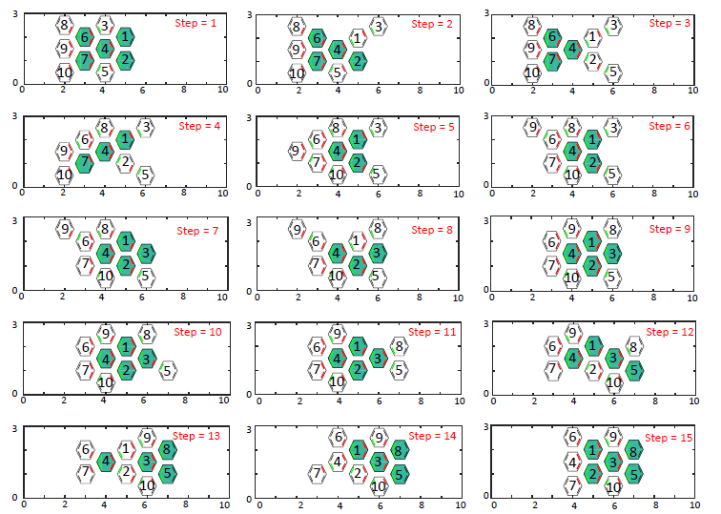
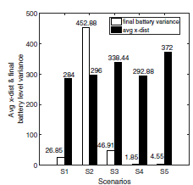
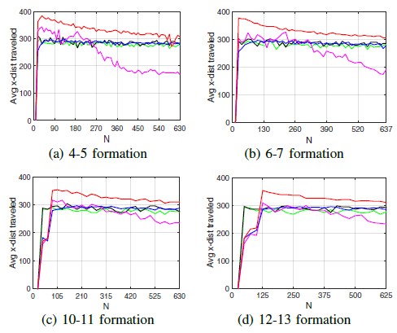
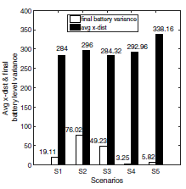
Packing of huddling penguins
Flank movement and charge sharing
Position shuffling progression
Simulation results

Slide 10
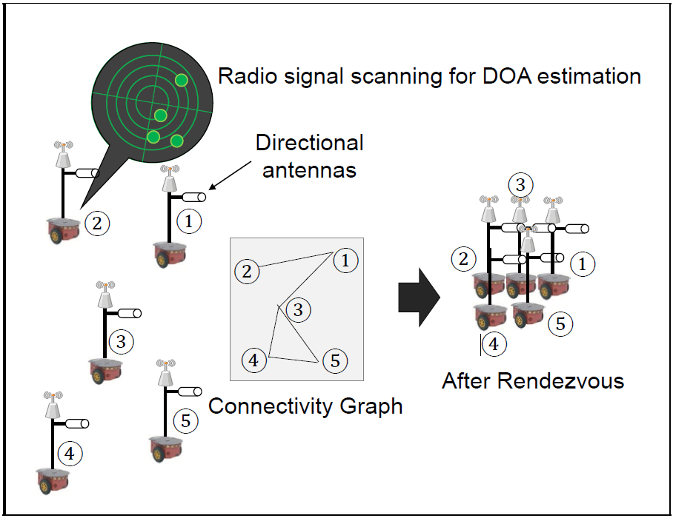
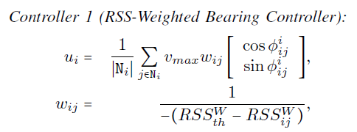
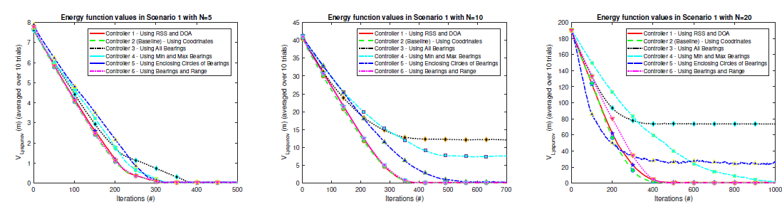
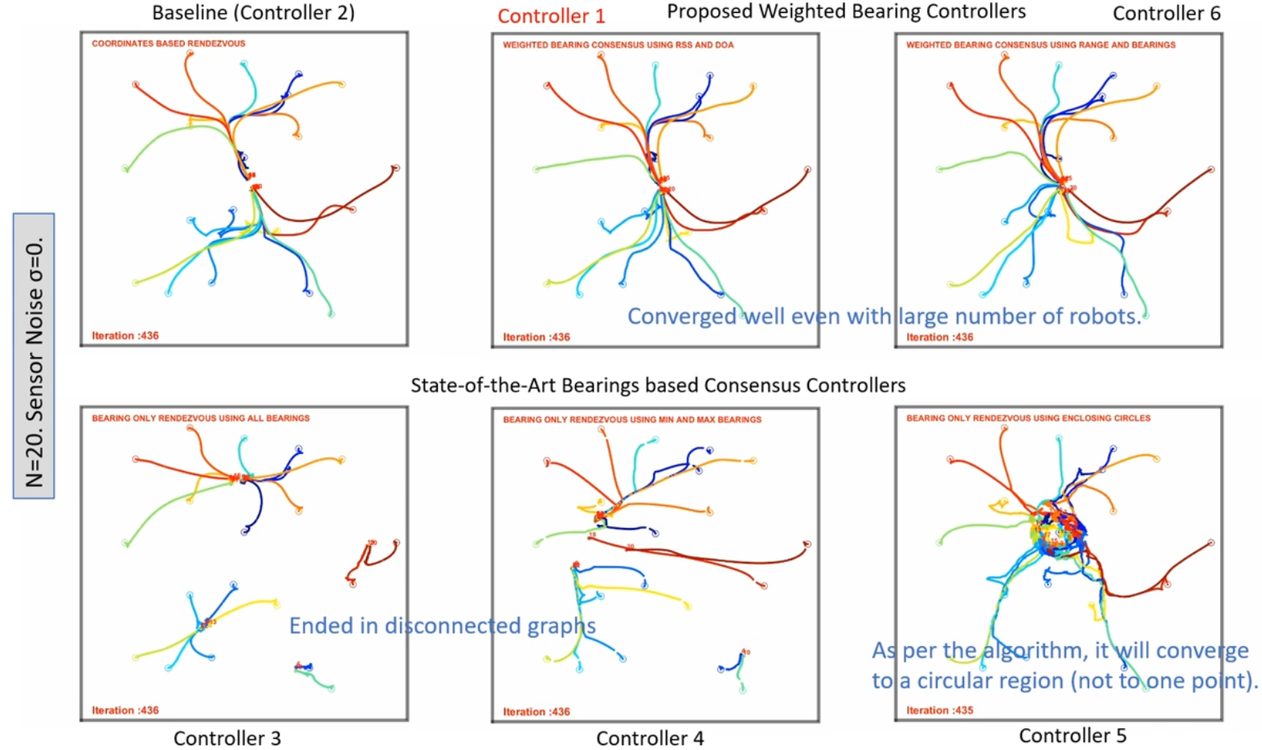
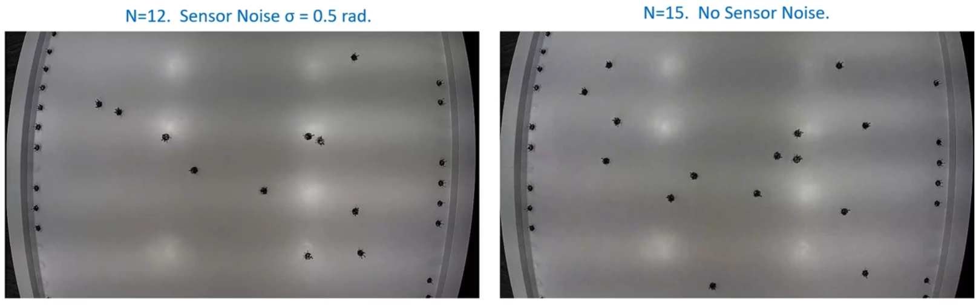
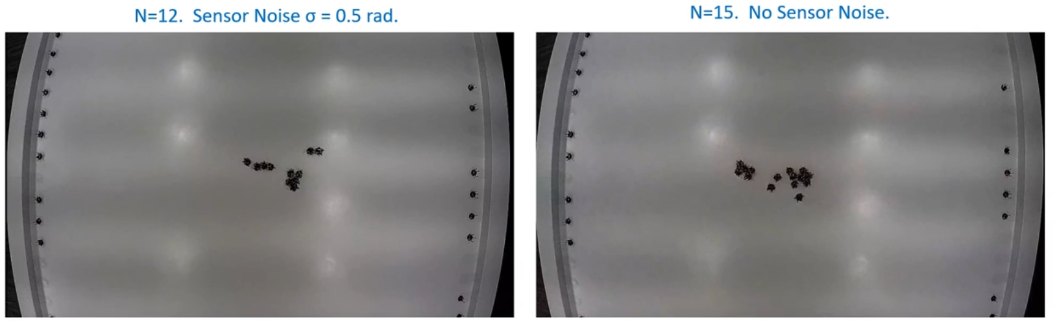
Proposed Controller
Illustration of the proposed controller
Simulation results
Example of Robotarium simulation
Experiments with Robotarium

Slide 11
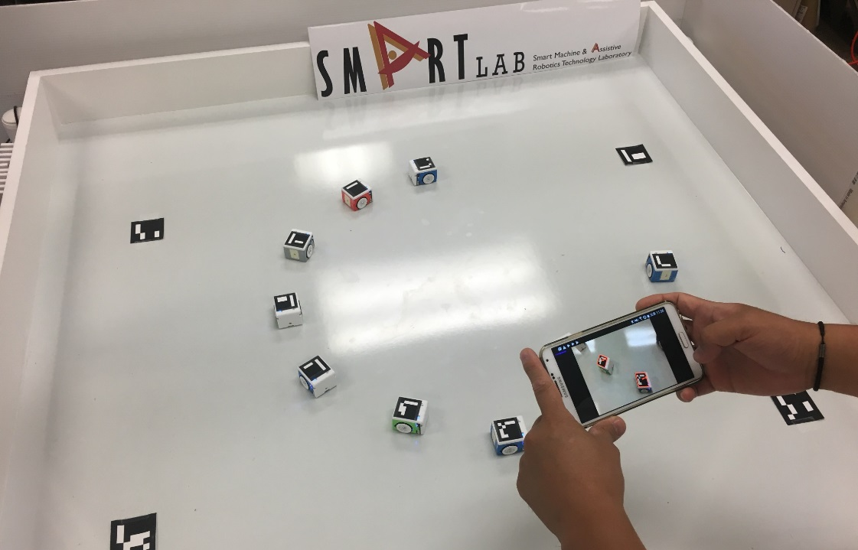

Slide 12
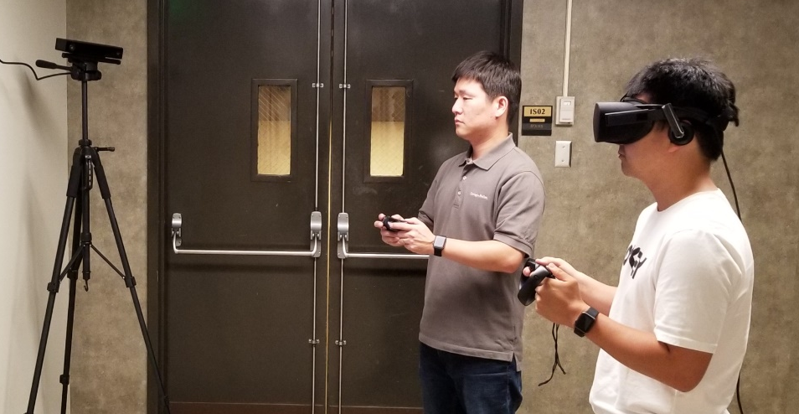
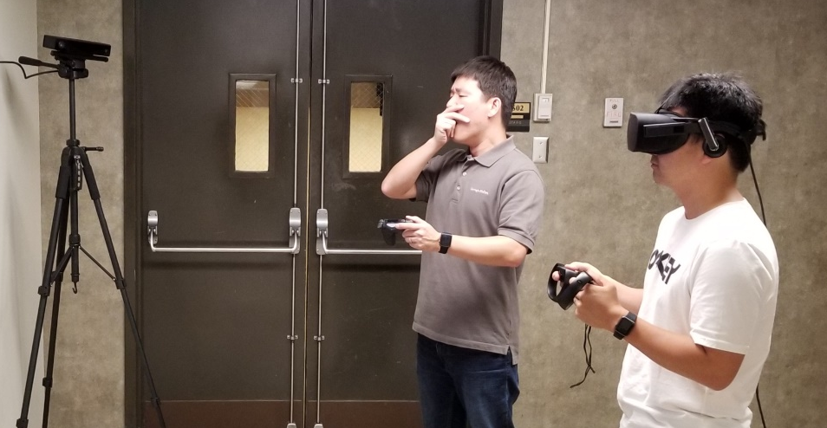

Slide 13

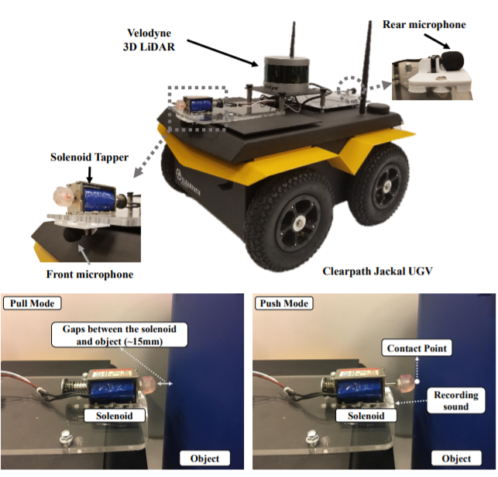
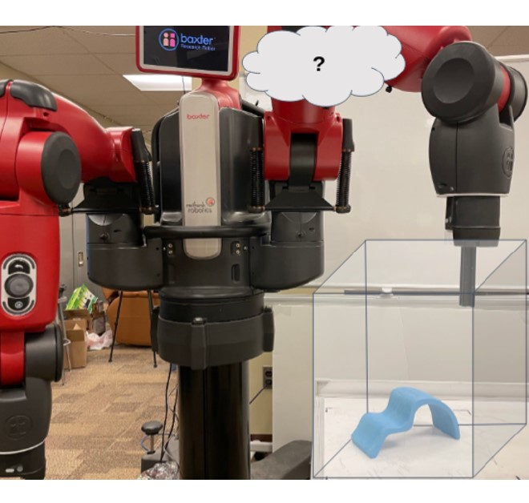
DRL-based Offloading
Material Mapping
Object Surface Reconstruction

Slide 14
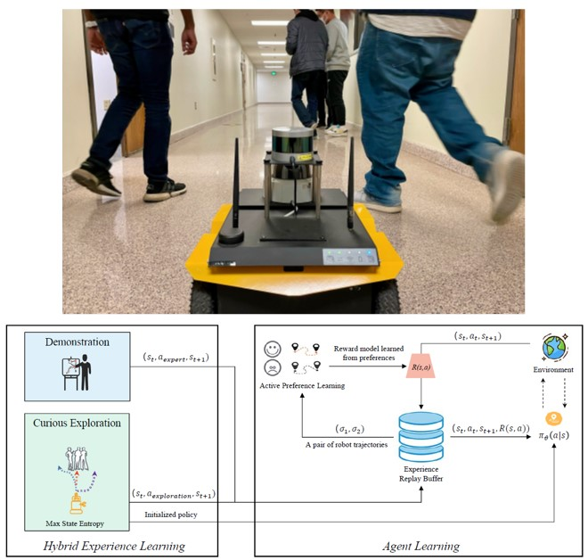
Socially-Aware Robot Navigation
Material Mapping
Object Surface Reconstruction

Slide 15
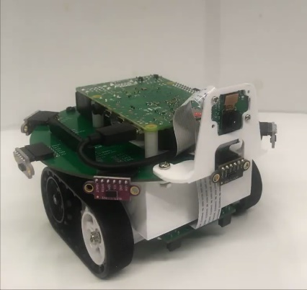
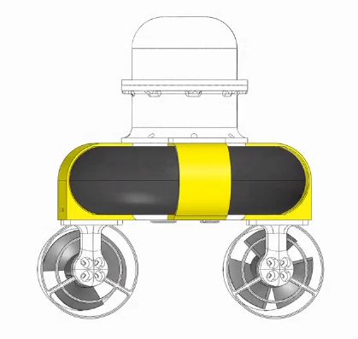
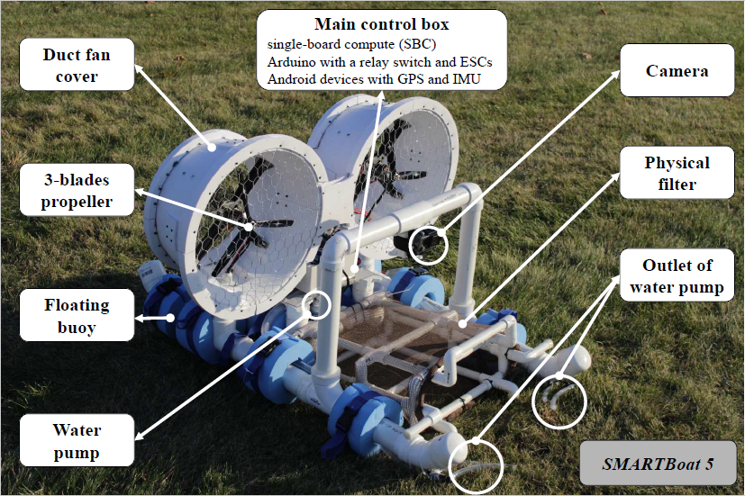
SMARTmBOT
SMARTBoat 3
SMARTBoat 5

Slide 18
Investigation on Accepted Package Delivery Location

Slide 19
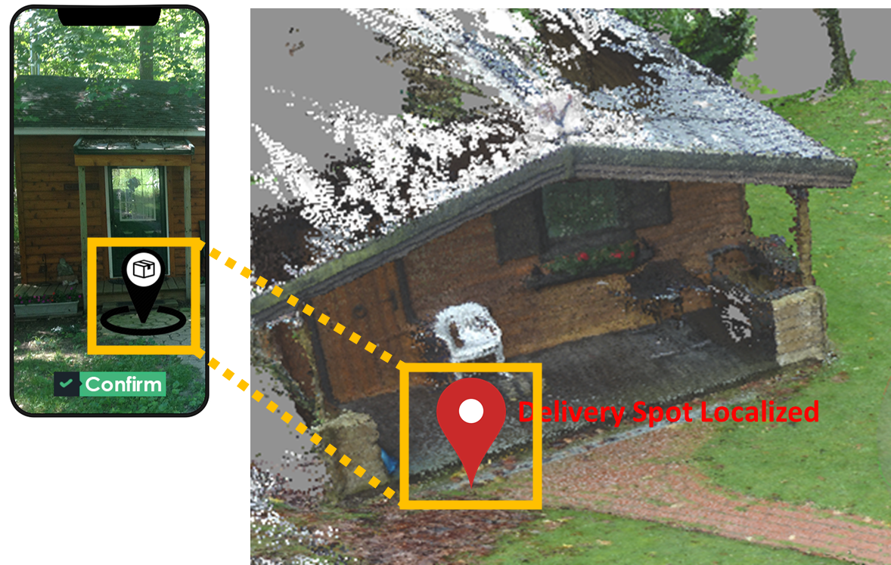
Delivery Spot Localization

Slide 20
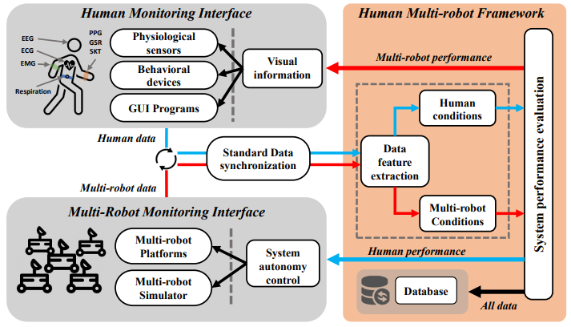
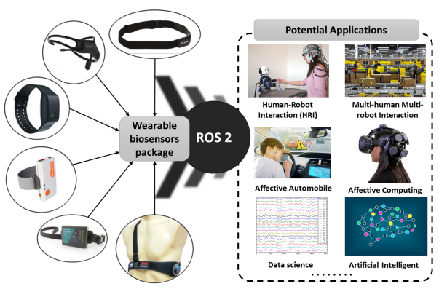
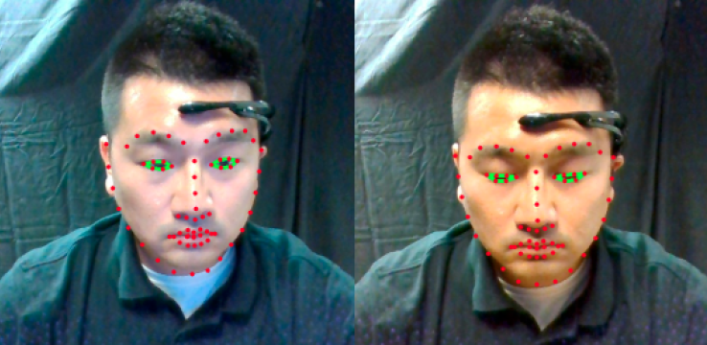
ROS 2 for Affective Computing
ROS-based framework
Examples of facial features

Slide 21
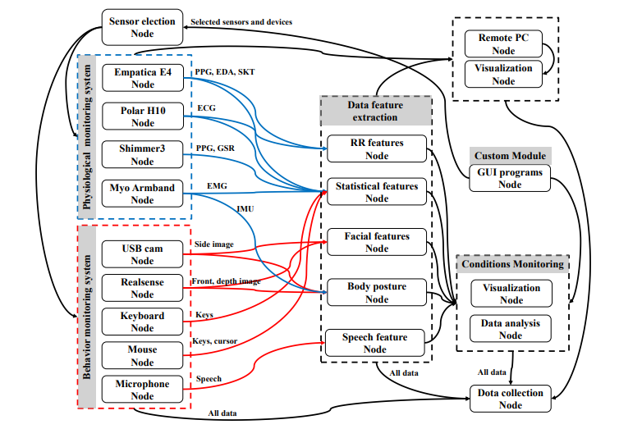
ROS-based framework
ROS 2 for Affective Computing
Examples of facial features

Slide 22
ROS node graph
ROS 2 for Affective Computing
Examples of facial features

Slide 23
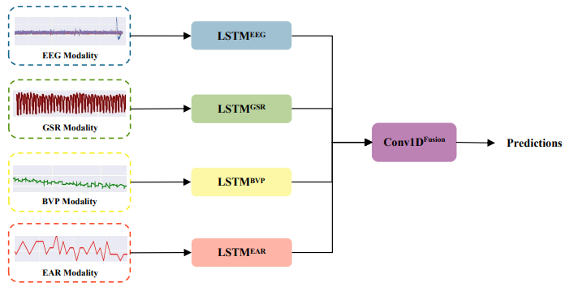
ML-based Classification
ROS 2 for Affective Computing
Examples of Facial Features

Slide 24
ML-based Classification
ROS 2 for Affective Computing
Examples of Facial Features

Slide 25
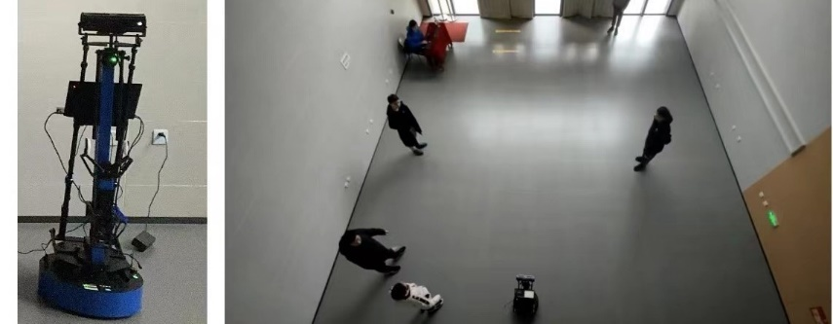
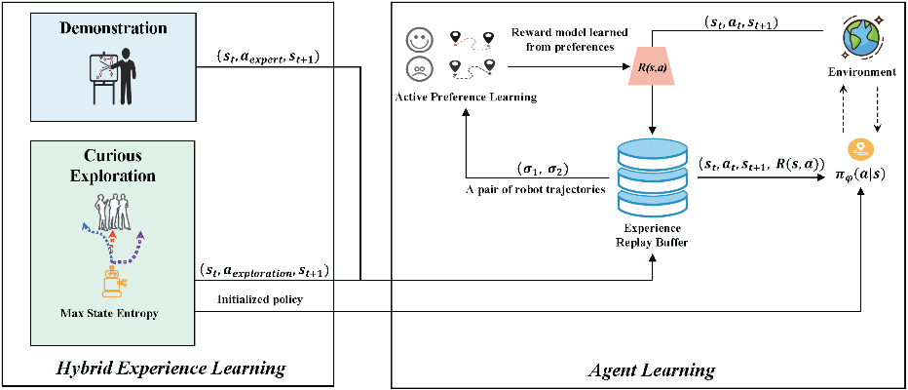
Test Setting
Learning Framework

Slide 26
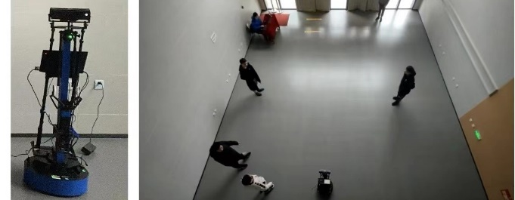
Test Setting
Learning Framework

Slide 27




Material Mapping
Object Surface Reconstruction

Slide 28



Predictive Algorithm
DRL-based Offloading

